Slide 1
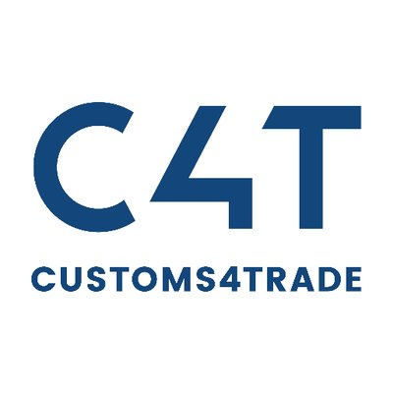
CUSTOMS4TRADE INTERVIEW ASSESSMENT
Isuru Gamage

Slide 2
Outline
Technical assessment choices
Technical assessment UML sequence diagram
SOLID principles
3.1. What is it?
3.2. Why does it matter?
3.3. Principles

Slide 3
Technical assessment choices
API Project: To create a REST API
Layered Architecture: To implement a loosely coupled testable application.
Swagger: To generate an interactive documentation.
Linq: To query object collections
AutoMapper: To map models to DTOs without implementing methods for that
Xunit: As the unit test framework to test functionalities
Moq: As the mocking framework to mock dependencies
Azure Service Bus Queue: As the messaging infrastructure
Visual studio 2019: As the development IDE
.NETCore 3.1: As the development frameowrk

Slide 4
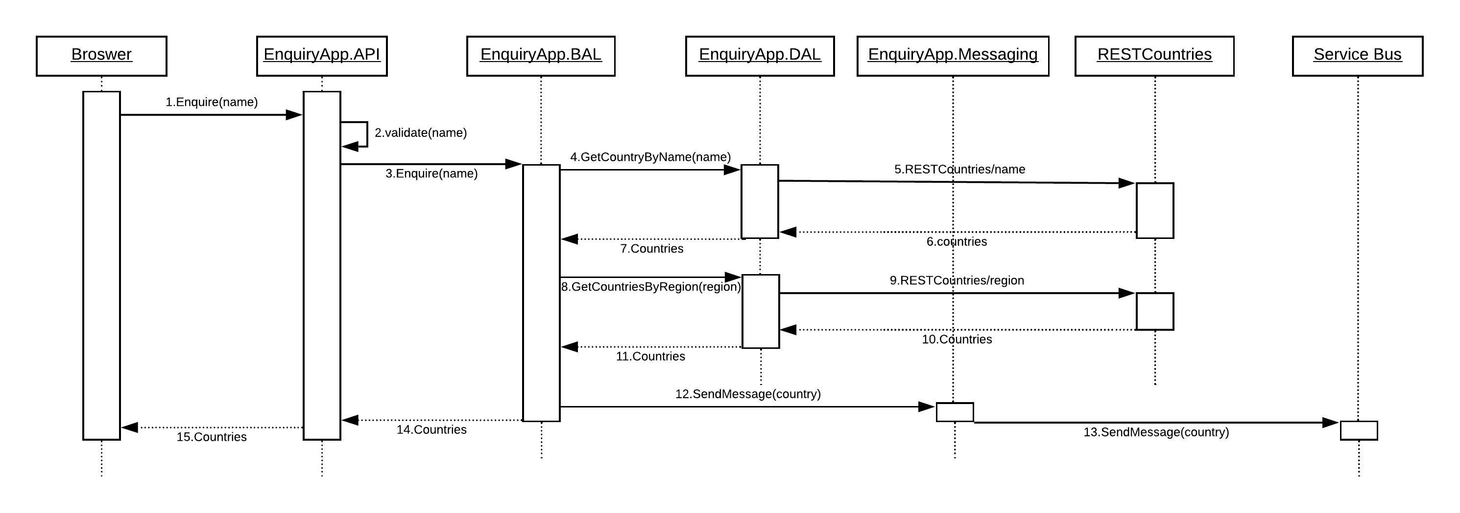
Technical assessment UML sequence diagram

Slide 5
SOLID: What is it?
Acronym for the first five object-oriented design (OOD) principles.
What it stands for.
S: The Single Responsibility Principle (SRP)
O: The Open Closed Principle (OCP)
L: The Liskov Substitution Principle (LSP)
I: The Interface Segregation Principle (ISP)
D: The Dependency Inversion Principle (DIP)

Slide 6
SOLID: Why does it matter?
Focus very tightly on dependency management.
Poor dependency management leads to.
Hard to change code
Fragile code
Non-reusable code
Well managed dependencies lead to.
Extensible code
Maintainable code
Reusable code
Avoids code smells
Easily refactor code
Part of the agile and adaptive SW development

Slide 7
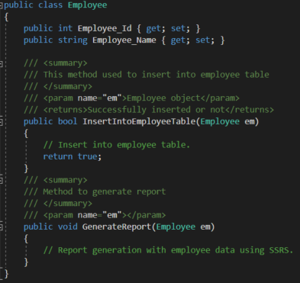
SOLID: Principles: SRP
The Single Responsibility Principle.
A class should have one, and only one, reason to change.
‘Employee’ class is taking 2 responsibilities.
Employee database operation.
Generate employee report.
Now what if customer asked you to give a facility to generate the
report in Excel?
‘Employee’ class will have to be changed.
The change will be for another reason.
This violates SRP.

Slide 8
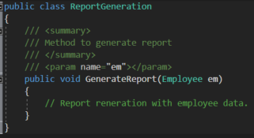
SOLID: Principles: SRP (Cont.)
How to overcome this?
Write a seperate class for report generation.
Now any change in report generation will not affect the
‘Employee’ class.

Slide 9
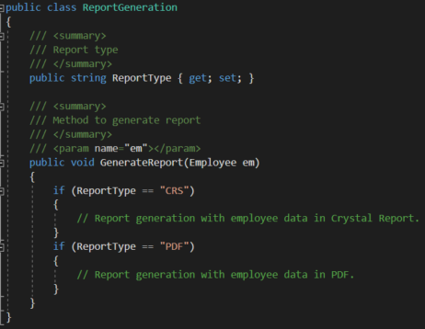
SOLID: Principles: OCP
The open closed principle.
A class should be open for extension but closed for modification.
Notice too many ‘if’ clauses in ‘ReportGeneration’ class.
Now what if we want to introduce another new report type like ‘Excel’?
Have to write another ‘if’.
We have to modify the class.
This violates OCP.

Slide 10
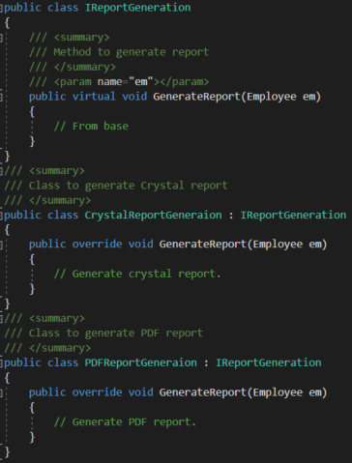
SOLID: Principles: OCP (Cont.)
How to overcome this?
Introduce an interface ‘IReportGeneration’ and allow sub
classes to implement the ‘GenerateReport’ method
for different types of reports.
Now if you want to introduce a new report type, then just inherit from
‘IReportGeneration’.
‘IReportGeneration’ is open for extension but closed for modification.

Slide 11
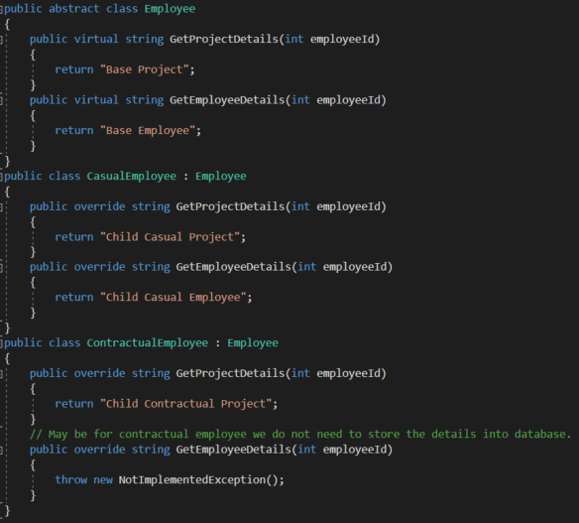
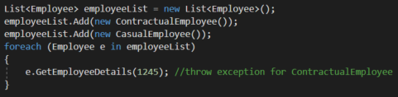
SOLID: Principles: LSP
The Liskov substitution principle.
If any module is using a base-class then the reference to that base-
class can be replaced with a derived-class without affecting the
functionality of the module.
‘GetEmployeeDetails’ throws an exception for
‘ContractualEmployee’.
‘ContractualEmployee’ looks like an “Employee” but
it is not an Employee.
So, the parent cannot replace the child object seamlessly.
‘ContractualEmployee’ is a different entity altogether.
This violates LSP.

Slide 12
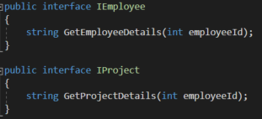
SOLID: Principles: LSP (Cont.)
How to overcome this?
Introduce two interface ‘IEmployee’ and ‘IProject’ and
implement according to employee type.
Now, contractual employee will implement ‘IProject’ not ‘IEmployee’ .
This will maintain LSP.

Slide 13

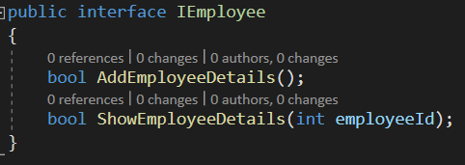
SOLID: Principles: ISP
The Interface segregation principle.
Any client should not be forced to use an interface which is
irrelevant to it.
There is one database for storing data of all types of
employees (Ex: Permanent, non-permanent).
What will be the best approach for our interface?
All types of employee class will inherit this interface for saving data.
Now suppose, we are asked to provide capability to read data for Permanent employees.
Shall we add ‘ShowEmployeeDetails’ method to this interface?
But now we are forcing non-permanent employee class to show their details from database.
This violates ISP.

Slide 14
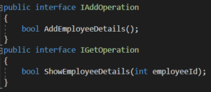
SOLID: Principles: ISP (Cont.)
How to overcome this?
Give the responsibility of showing database details to
another interface.
Now, non-permanent employee will implement only ‘IAddOperation’
and permanent employee will implement both the interface.
This will maintain ISP.

Slide 15
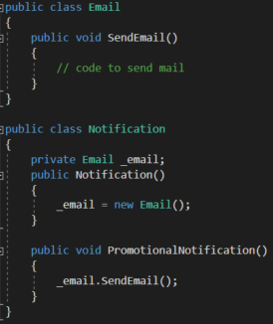
SOLID: Principles: DIP
The Dependency inversion principle.
Entities must depend on abstractions not on concretions.
High level module must not depend on the low level module.
But they should depend on abstractions.
Abstractions should not depend on details.
Details should depend on abstractions
Suppose a notification system.
Notification class totally depends on Email class, because it
only sends one type of notification.
If we want to introduce any other like SMS then? We need to
change the notification system also.
This is called tightly coupling.

Slide 16
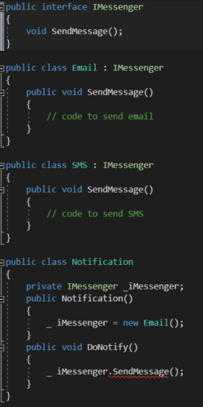
SOLID: Principles: DIP (Cont.)
Let’s try to make it loosely coupled.
Is this loosely coupled?
No, still the Notification class depends on Email class.

Slide 17
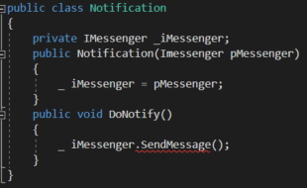
SOLID: Principles: DIP (Cont.)
Now, let’s use dependency injection so that we can make it
loosely coupled.
Now client is responsible for providing the suitable
Instance (Email or SMS).
This will maintain DIP.

Slide 18
THANK YOU

